Slide 1
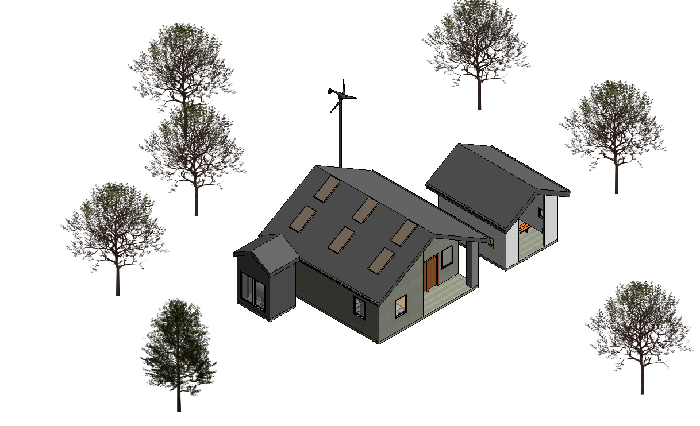
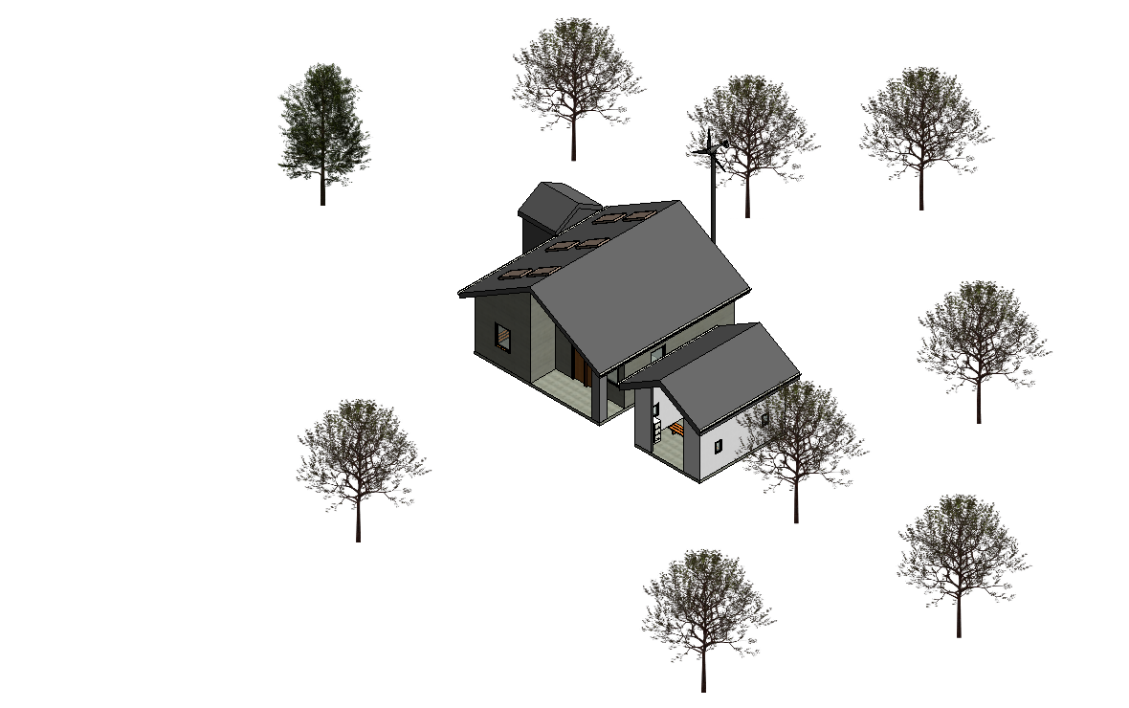
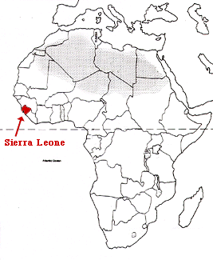
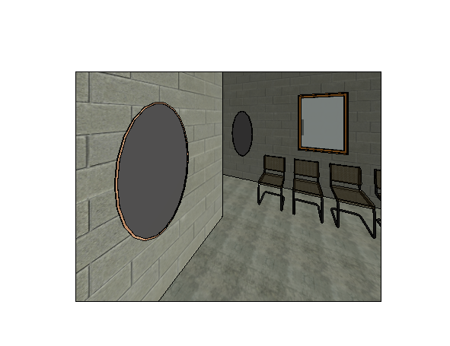
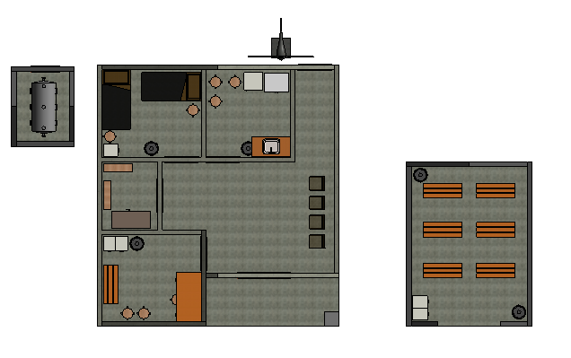
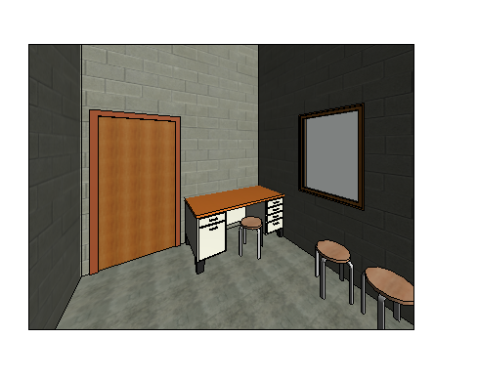
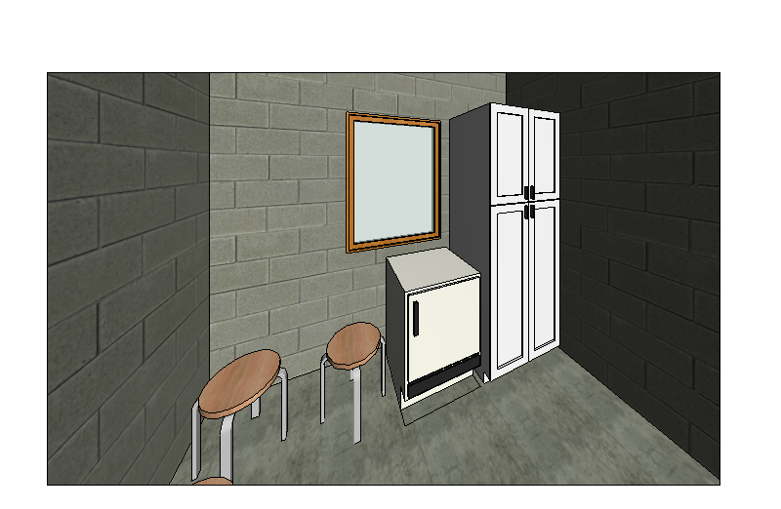
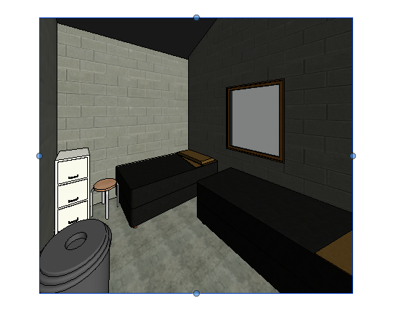
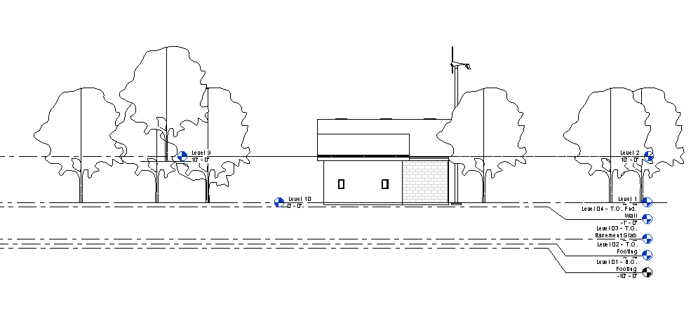
Primary Care Medical Health Center
Jake Evans, Tommy James, Buck Kauffman
EGR 343: Green Architectural Engineering
Elizabethtown College, Elizabethtown, PA
Project Constraints
Design Features
Structure
Concrete slab floor (27’x25’x3”, 6.25 cu yards)
Walls created with mud bricks (dry season) or concrete blocks (wet season)
Aluminum sheet roof with a Thatched roof above (Ventilation)
Trusses, door frames, and window frames will be made from local wood and assembled on site
Windows will have shutters that open outward for air flow and lighting, without having to use glass
Doors will be imported from local dealers made from wood
Ceramic tile will be used in the observation and sterilization room for sanitation
Sustainable Energy Sources
A 3 kilowatt PV system will be installed with solar panels on the roof facing the South end for maximum sun exposure
A windmill will be placed on the back of the building facing East to take advantage of the Harmattan winds
Water Use
A rain catchment system will be used to collect rainwater from the downspouts of the structure
A large tank located on the back side, exposed to Southern light for natural heating will store the water collected for use in the facility
This tank will be in a small structure with low density brick walls and a south facing window made of Plexiglas
Interior Furnishings
Stools will be in each room for faculty and patient use
A desk will be in the consultation room for the faculty
Cabinets will be in all rooms for storage and a tabletop like surface
Beds will be in the observation room for ill patients
A bench will be in the consultation room for faculty to examine patients, and fit entire families
A chair with a sturdy back and mats for the floor will be in the physical therapy room for the patients
Mirrors in the therapy room will be used for exercises to watch form and posture
Medical Equipment
Hazardous material containers will be in each room
A sink and fridge will be in the Sterilization and Treatment room for sanitation and medical supplies
50 sites with varying environments in Sierra Leone in West Africa
Footprint based on existing buildings, 27’x25’
Limited resources, local materials preferred
Cost kept to a minimum due to local economy
Medical Supplies
Essential equipment- syringes, needles, defibrillators, exam table paper, etc.
Essential Medications- based off of World Health Organization standards.
Ebola suits will be located in the store room if a major outbreak arises around the health center.
Therapy Room
Consultation Room
Sterilization and Treatment Room
Ebola Screening Tent
Observation Room

